Slide 1
Awakening Excellence.1
Systems, Strategies and Concepts for Awakening Excellence

Slide 2
Offered By
Total Integration
Institute
All Rights Reserved
© 2023

Slide 3
Developed and Presented by
Diamond and River Jameson
Founders of the Total Integration Institute

Slide 4
Context First

Slide 5
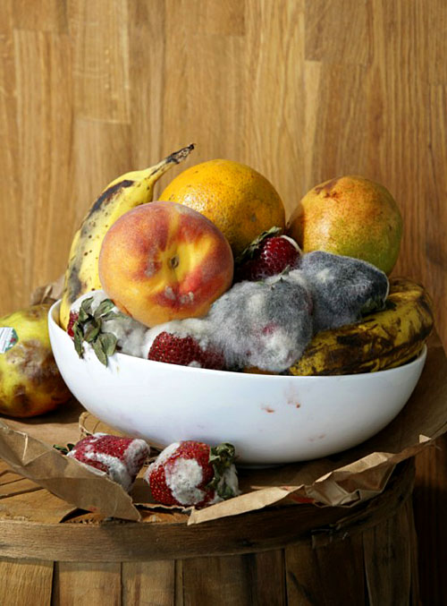
Context and Content
The Bowl and The Fruit

Slide 6
Domain, Context, Paradigm
Denial
Addiction
Survival
Integral
It's Your Choice

Slide 7
Domain, Context, Paradigm
Drama
Denial
Struggle
Dis-Connected
Stressed
Overwhelmed
Lack of Trust
Difficult World
Denial
Addiction
Survival

Slide 8
Domain, Context, Paradigm
Breathing
Connected
Whole
Embrace
Love
Thriving
Basic Trust
Easy World
Integral

Slide 9
The Issue is not Humanity
The Issue is Context
It's Your Choice

Slide 10
Context
Pre-determines
The Probable
Outcome

Slide 11
Domain, Context, Paradigm
Denial
Addiction
Survival
Integral
It's Your Choice

Slide 12
Where do you Identify?
Old Context
or
New Context

Slide 13
1 Foot on the Shore
1 Foot on the Boat
Both Feet into the New

Slide 14
Be a
Reality
Artist

Slide 15
Co-Create
a
New Context
For Our Planet and World

Slide 16
What’s First?

Slide 17
Context First

Slide 18
Functionality
Functional Business = Successful Business

Slide 19
Three Areas
Team
Process and Systems
Product or Service
Excellence in All means Excellence throughout!

Slide 20
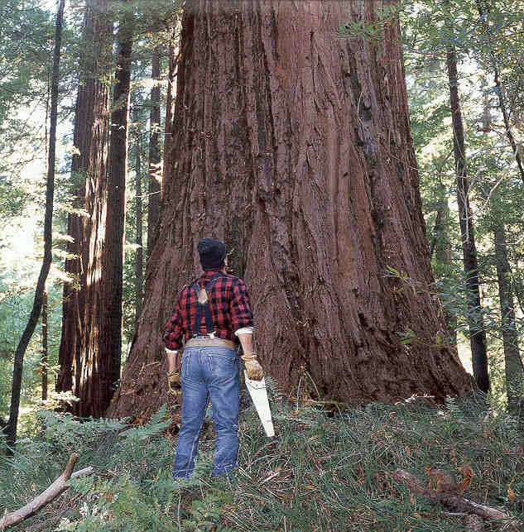
Functionality
Do what works.
Stop doing what does not work.

Slide 21
Team-Partnership

Slide 22
Awakening Excellence
Systems, Strategies and Concepts for Awakening Excellence

Slide 23
Language
Languaging

Slide 24
Assertion Declaration
I declare....
I intend....
I commit....
I promise....

Slide 25
“There is Always a Resolution”
Be the Resolution.

Slide 26
Affirmation
A Beneficial Positive Intention:
“Our meeting today will
benefit everyone involved”

Slide 27
Afformation
I Wonder....?
I Wonder what’s the best way to do this...?
Future: I Wonder how we had so much success.

Slide 28
Afformation
Empowered Answers
come from
Empowered Questions.

Slide 29
Neural Net
2000 Bits vs. 4 Billion

Slide 30
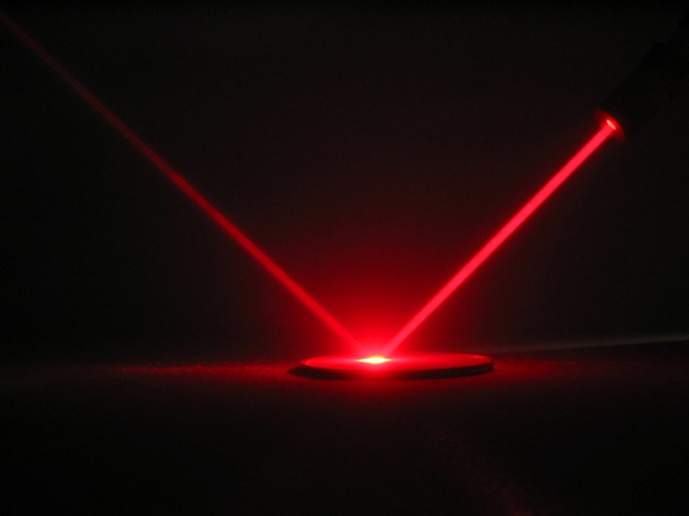
“Clarity Brings Power.”

Slide 31
“Clarity Brings Power.”
Marginalized Voice

Slide 32
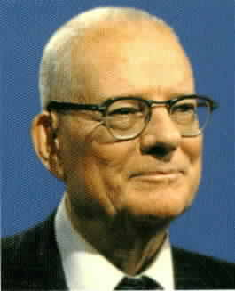
First 15%
Edwards Deming

Slide 33
First 15%
Goal
15%
85%

Slide 34
Last 5%
Goal
15%
5%
80%
Impeccable Completions

Slide 35
Change
What do you believe?

Slide 36
Beliefs about Change
Change Hurts
Change is Hard
Change is Painful
Change Never Really Happens

Slide 37
Change Model
Crisis
Pain
Energy and $
Discomfort
Point Easy
Time
“Change Can Be Easy”

Slide 38
Change Model
Crisis
Energy and $
Pain
Discomfort
Point Easy
Time
“Change Can Be Easy”

Slide 39
You are the Nucleus of Your Reality
Nucleus
Where ever you go
There you are!

Slide 40
Nucleus Relationships
Nucleus
Self
Life
Earth

Slide 41
You are the Nucleus of all your Relationships
Nucleus
Family
Friends
Community/Work
World

Slide 42
Healthy Nucleus?
Nucleus
Self
Life
Earth
Nucleus
Family
Friends
Community/Work
World

Slide 43
Nucleus Effect
Nucleus Power
Nucleus
Family
Friends
Community/Work
World

Slide 44
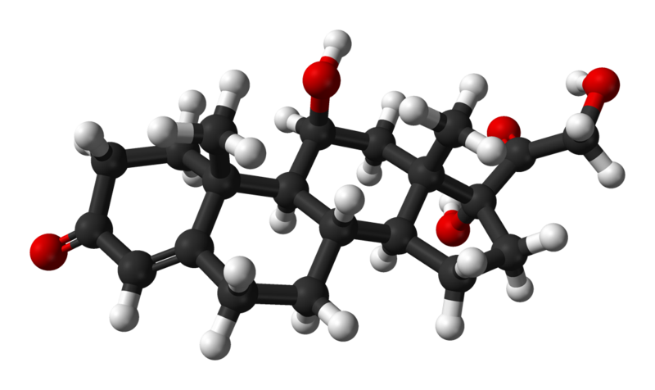
1400

Slide 45
Stress

Slide 46
Stress
Stress
Is an Alert.

Slide 47
Stress
Release

Slide 48
60 Sec Burst

Slide 49
60 Sec Burst
How To Burst

Slide 50
Awakening Excellence

Slide 51
Awakening Excellence.2
Systems, Strategies and Concepts for Awakening Excellence

Slide 52
Five Islands

Slide 53
Relationships
2
3

Slide 54
Relationships
Are the Foundation of All Economics
Higher Connectivity & Functionality =
Higher Economic Potential

Slide 55
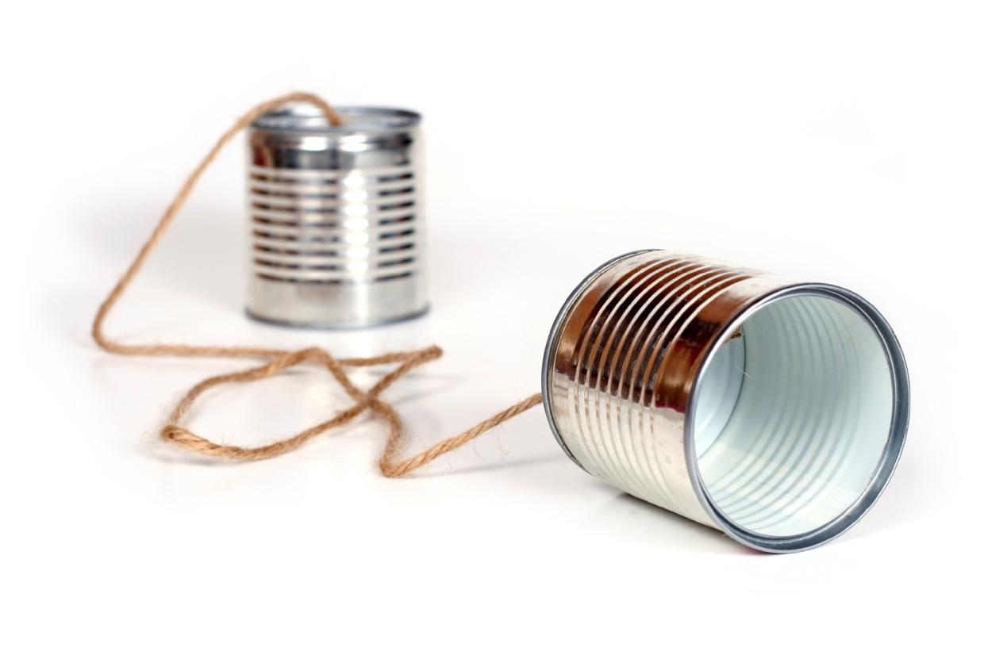
Empowered
Communication.1

Slide 56
Empowered Communication
Creates Results

Slide 57
Empowered Communication
Requires
Active Listening
Empowered Requests
Empowered Promises

Slide 58
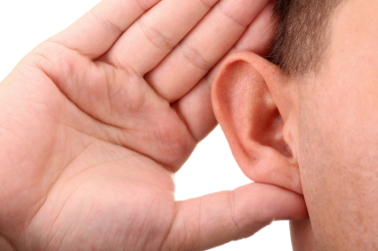
Empowered Communication
Active Listening
"Clarity Brings
Power."

Slide 59
Empowered Communication
Actively Listen
to
What is Said
(Hear, See, Feel and Sense)
For clarity
Repeat what was Said.
"Is what I have repeated correct?”

Slide 60
Empowered Communication
Actively Listen
to
What is Heard
(Hear, See, Feel and Sense)
For clarity
Ask listener to repeat.
“For clarity could you repeat what I said?”

Slide 61
Empowered
Requests
Creates Results

Slide 62
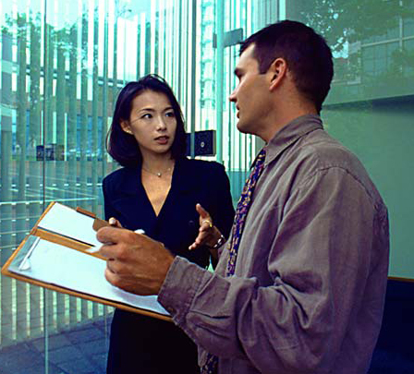
Empowered Requests
“I have a Request.”

Slide 63
Empowered Requests
“I have a Request.”
Why
Qualifications for Satisfaction
Time Line
Considerations
Listen the Promise
Consequences

Slide 64
Empowered
Communication
Write Down an Empowered Request

Slide 65
Empowered Communication
Empowered
Promises
Create Results

Slide 66
Empowered Communication
Empowered Promise
“I Promise.”

Slide 67
Empowered Promise
Understand the Why
“I Promise.”
To Satisfy the Qualifications
Time Line
Considerations
Listen my Promise
Consequences

Slide 68
Empowered Promise
Agreements
I will keep my
Promises and Commitments
Promises and Commitments
Can only be changed by agreement.

Slide 69
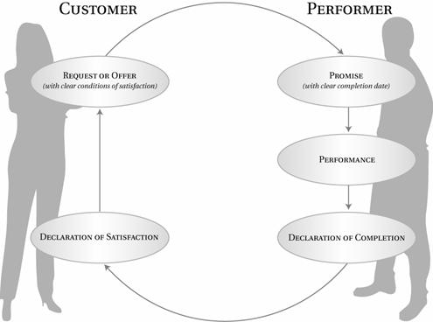
Conversation for Action Cycle
Requester
Performer
Conversation
For Action
Empowered Request
Empowered Promise
Authentic Revealing
Considerations
Suggestions
Performance
Declaration
Of Satisfaction
Declaration
of Completion
Resourced from Fernando Flores

Slide 70
Empowered
Communication.2

Slide 71
Challenging Conversations

Slide 72
Challenging
Conversations
Are conversations that take place when
the stakes are high, opinions differ,
and emotions run strong.
How you handle challenging conversations
can determine your success in your most important relationships, whether at home,
at work, or in a social organization.

Slide 73
The Signs of
Challenging Conversations
When you feel
Stuck, Stressed, Emotions,
Body Symptoms
Behaviors, Acting Out, Raising Voice, Withdrawing or Withholding.
There is a
Challenging Conversation
You need to Have.

Slide 74
Change Model
Crisis
Pain
Energy and $
Discomfort
Point Easy
Time
“Change Can Be Easy”

Slide 75
Are there Challenging Conversations You need to have?
Identify challenging conversations
that you’re not holding or not holding well.
Write the title of these on a sheet of paper.

Slide 76
Communication for Resolution
Model

Slide 77
Communication for Resolution
Dialogue
For Resolution
Pool of Shared Meaning
“The pool of shared meaning is the birthplace of Synergy.”

Slide 78
Communication for Resolution
Silence
Withdrawing, Avoiding, Masking
Safety
Dialogue
For Resolution
Pool of Shared Meaning
Safety
Controlling, Labeling, Attacking
Violence

Slide 79
Dialogue Goals
Denial Context Unhealthy Goals
Be Right
Look Good Save Face
Keep the Peace
Avoid Conflict
Win - Lose
Punish, Blame
Separate and Isolate
Integral Context
Healthy Goals
Find the Truth
Admit. Learn. re-Commit.
Acknowledge Challenge
Commit to Resolution
Win - Win. Produce Results
Request and Resolve
Inclusion, Synergy, Partnership

Slide 80
Start and Stay with Heart
Work on me First.
What do I really want?
What do I really want for myself?
What do I really want for others?
How would I behave
if this is what I really wanted?

Slide 81
Refuse Either Or Thinking
Search for an
And
Clarify what you don’t want
Ask brain to search for healthy options
There is a Resolution What is it?

Slide 82
Learn to Look
Look at Content and Conditions
Watch for Safety problems
Look for people moving towards
Silence and Violence
Look for your Style Under Stress

Slide 83
When you or others are moving toward
Silence or Violence
Make it Safe
Step out of Content
Out of Conversation
And Make it Safe

Slide 84
Make it Safe
Which Condition of Safety is at Risk?
Mutual Purpose
Do others believe you care about their goals?
Mutual Respect
Do others believe you respect them?

Slide 85
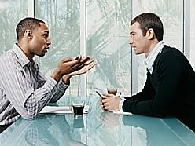
Make it Safe
When there is Misunderstanding
Use
Contrasting
Start with what you don’t intend and mean.
Explain what you do intend and mean.

Slide 86
Tough Message to Share
State Your Path

Slide 87
Your Path
See
Hear
Sense
-Story
Is that True?

Slide 88
Your Path
See
Hear
Sense
- Story
- Feel
-Act

Slide 89
Communication for Resolution
Silence
Withdrawing, Avoiding, Masking
Safety
Dialogue
For Resolution
Pool of Shared Meaning
Others
See
Hear
Sense
Me
See
Hear
Sense
-Story
-Story
-Act
Act
-Feel
-Feel
Safety
Controlling, Labeling, Attacking
Violence

Slide 90
Tough Message to Share
State Your Path
Share your Facts
Start with least Controversial
Tell your Story
The meanings you are giving to the facts.
Ask Others for their facts and Stories
Dialogue for Resolution

Slide 91
Dialogue for Resolution
Agree
When you do.
Apologize
Quickly when appropriate.
Build
If others leave things out
Agree where you do then Build…. (AND)
Compare
When you differ significantly
Don’t suggest they are wrong. Compare the two Views.

Slide 92
Dialogue for Resolution
Mutual Purpose
Pool of Shared Meaning
What do I Really Want
Move Energy
Search for And
Watch for Safety
Active Listening
Contrasting
Share Your Path
Resolution

Slide 93
Awakening Excellence.3
Systems, Strategies and Concepts for Awakening Excellence

Slide 94
Emotional
Intelligence

Slide 95
Working with Emotional Intelligence
Daniel Goleman
67% of all competencies deemed essential for high performance were related to emotional intelligence.
One’s emotional intelligence mattered twice as much as one’s technical knowledge or IQ for this high performance.

Slide 96
What is Emotional Intelligence (EQ)?
1. The ability to be aware of, name, and
manage one’s emotions
2. The ability be aware of, name and
understand other’s emotions
3. The ability to relate to others in effective
ways both personally and professionally
in a wide range of contexts and roles
Mark Craemer Consulting

Slide 97
How does low EQ show up at work?
Blaming others
Victim statements such as “If only he/she would . . .”
An inability to hear critical feedback
Diverse opinions that are not welcomed or valued
Passive, aggressive or passive-aggressive communication
Leaders who do not listen and become out of touch with those they lead

Slide 98
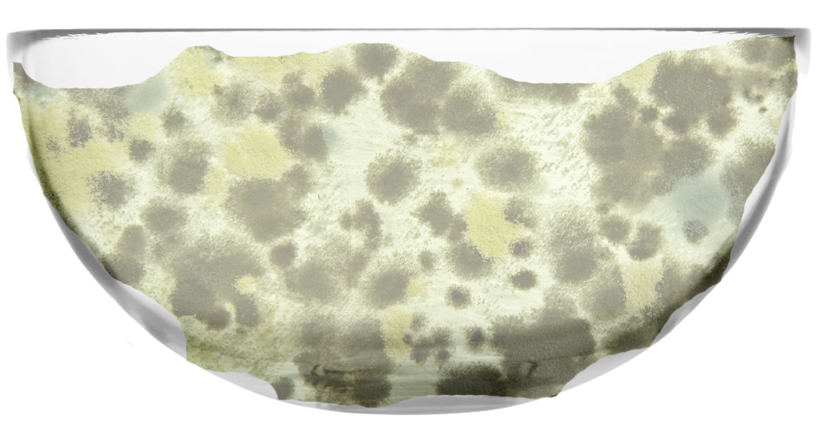
Domain, Context, Paradigm
Integral
Denial
Addiction
Survival
It's Your Choice.

Slide 100
Feelings and Emotions

Slide 101
Feelings and Emotions
are
Energy

Slide 102
Feelings and Emotions
are
Messengers

Slide 103
Feelings and Emotions are
Messengers
Love and Ease = You’re On Track

Slide 104
Feelings and Emotions are
Messengers
Love and Ease = You’re On Track
Dissonating Feelings = Need for Change

Slide 105
Crisis
Pain
Energy and $
Discomfort
Point Easy
Time
“Change Can Be Easy”

Slide 106
Real Feelings
and
Addictive
Thought Generated Feelings

Slide 107
Real Feelings = Breakthrough
Addictive
Thought Generated Feelings = Loop

Slide 108
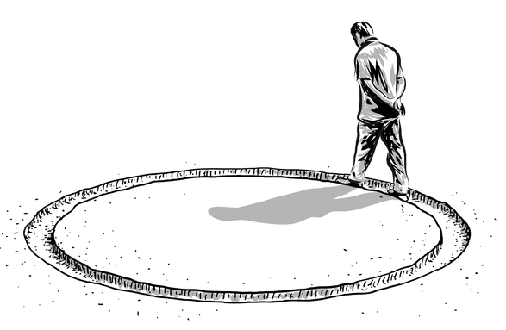
Looping?
What would I really be feeling?

Slide 109
Feelings and Emotions
are Messengers
Dissonating Feelings = Need for Change
Fear
Anger
Sadness

Slide 110
Breathing

Slide 111
Awakening Excellence

Slide 112
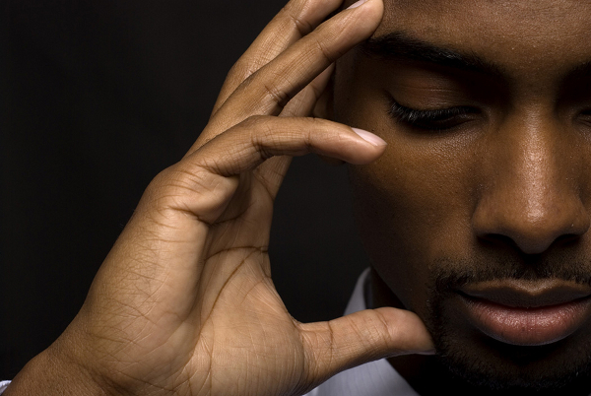
Beliefs

Slide 113
Beliefs
Are like Bricks in a Wall
Bricks = Beliefs
Mortar = Energy

Slide 114
What is Real is Real

Slide 115
And Real Can Change

Slide 116
Whole Process
Integral

Slide 117
Domain, Context, Paradigm
Integral
Denial
Addiction
Survival
It's Your Choice.

Slide 118
Whole Process
Breathe, Be Present
Embrace and Vibrate Emotions
Release Limiting Beliefs
Declare New Intention
Empowered Action

Slide 119
Mar 22-26

Slide 120
Breathing

Slide 121
Awakening Excellence
Systems, Strategies and Concepts for Awakening Excellence

Slide 122
Core Practice
Sobriety and Impeccability

Slide 123
Sobriety
Being Present
Connected
Stable and Sane.

Slide 124
Sobriety
The Zone
Clear-headedness
Facing intensity without loosing your marbles

Slide 125
Sobriety = State
Impeccability =
Action/Behavior

Slide 126
Impeccability
Actions and Behaviors
that
Builds Power, Adds Value.
(Not Perfectionism)

Slide 127
Core Practice
Sobriety and Impeccability

Slide 128
Breathing

Slide 129
Awakening Excellence
Systems, Strategies and Concepts for Awakening Excellence

Slide 130
Toxic Shame
and
Healthy Shame

Slide 131
Toxic Shame
“There's something wrong with me."

Slide 132
Toxic Shame
“There's something wrong with me."
Lie

Slide 133
Toxic Shame
“There's something wrong with me."
Healthy Shame
"I made a mistake and I need to make a change."

Slide 134
Toxic Shame
“There's something wrong with me."
Lie
Healthy Shame
"I made a mistake and I need to make a change."

Slide 135
Responsibility

Slide 136
Responsibility
Response-Ability
The Ability to Respond.

Slide 137
Breathing

Slide 138
Awakening Excellence

Slide 139
Addiction

Slide 140
Addiction
Costly to…
Self | Others | Business.
Re-Frame:
Face, Resolve,
Release Judgment

Slide 141
To Heal and Resolve
Addiction
Requires a Multi-dimensional
Integral Approach
Mind. Body. Emotions. Spirit.
Context. Relationships. Life Skills.
Whole Being. Whole Life.

Slide 142
Addiction
Addiction is anything we
do over and over again,
instead of having our true authentic experience and feelings.

Slide 143
All Addictions
are
Preoccupation
Addictions

Slide 144
Addiction
Addiction is anything we do over and over again, instead of having our true authentic experience and feelings.
We train ourselves until it feels like a
‘have to’ or until it becomes an
Automatic Compulsivity.

Slide 145
3 Kinds of Addictions
Substance
Relational
Process

Slide 146
Its Not Alcoholism
Its Not Addiction
It’s
Dependency

Slide 147
All Addictions
Are
Dependencies
Used to
Preoccupy
Away from the
Cure

Slide 148
The Cure
is Embracing the
Pain or Challenge
One has been
Avoiding and Denying

Slide 149
The Cure
Requires a Multi-dimensional
Integral Approach
Mind. Body. Emotions. Spirit.
Context. Relationships. Life Skills.
Whole Being. Whole Life.

Slide 150
Breathing

Slide 151
Awakening Excellence
Systems, Strategies and Concepts for Awakening Excellence

Slide 152
Over Commitment A Costly Lie

Slide 153
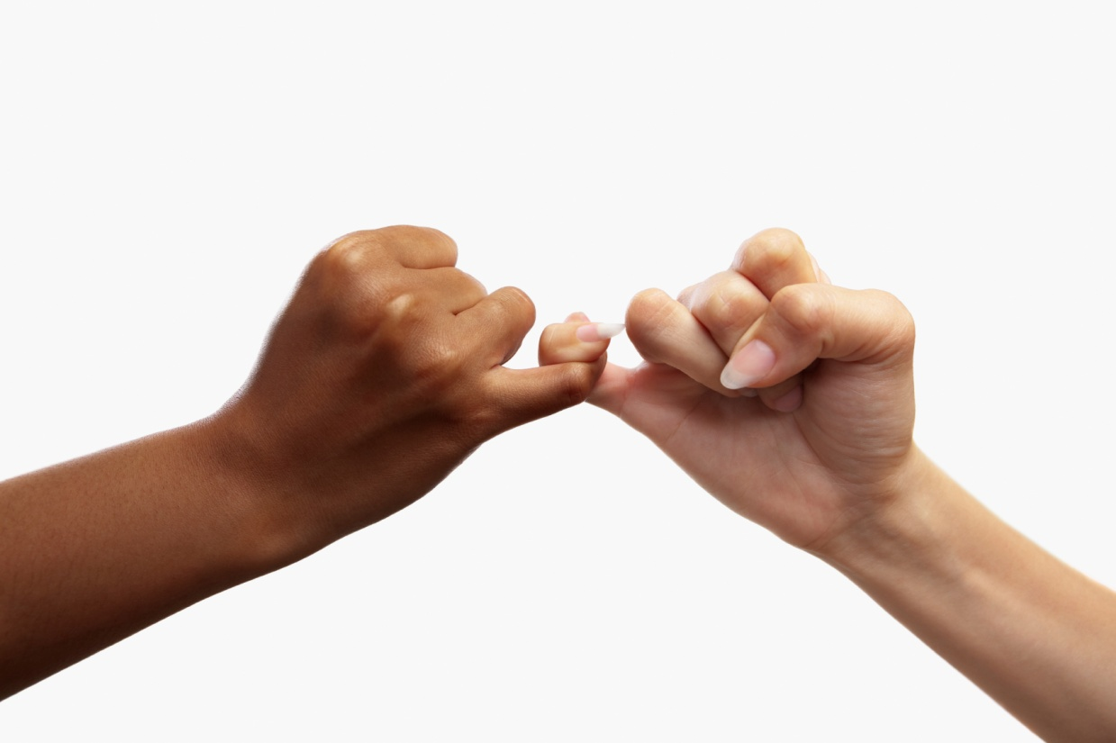
Commitments
Promises
Excellence

Slide 154
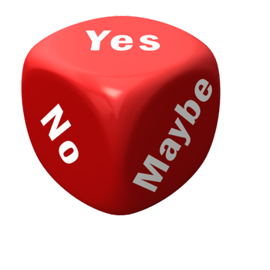
Commitments
Promises
Yes, No, Maybe So

Slide 155
Commitments
Promises
Complete it, Delegate it
or Re-Negotiate it.
I will not Abandon it.

Slide 156
Commitments
Promises
Requires Resources
Time, Space, $’s, Team
Creativity, Ingenuity, Energy

Slide 157
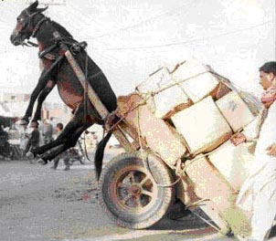
What is the Result
of keeping your
Commitments & Promises?

Slide 158
The Result of Keeping your Commitments and Promises.
Trust
Abundance
Satisfaction
Fulfillment
Freedom

Slide 159
Over Commitment
Is a False Promise
It’s a Lie

Slide 160
Over Commitment
It’s a Lie
It’s Saying Yes
Instead of Saying
No or Maybe so

Slide 161
Over Commitment: It’s a Lie
At Best I’ll Deliver
Late
Quality Less than Promised
80%, 70%, 60%
or
Abandoned
And not delivered at all…

Slide 162
Over Commitment: It’s a Lie
The Cost:
Unknown, Unknowable
Break of Trust
Negative Fall out Downline
Effecting others Reputation
Sacrifices Family, Body,
People Mad at you

Slide 163
Over Commitment
False Promise: It’s a Lie
Triggers Toxic Shame
“There’s something wrong with me”

Slide 164
Over Commitment
Triggers
Bio-Chemistry
Overwhelm, Urgency, Toxic Shame
Addiction to the Bio-Chemistry
Numbness – Disassociation
Shameless Behavior
It’s Saying Yes…
Instead of No or Maybe So.

Slide 165
Over Commitment Cycle
Toxic Shame
“There's something wrong with me”
So, because I believe:
“There’s something wrong with me,”
I need to Over Commit even more…
Then I Don’t deliver Again and Again.
And then I need to……………..

Slide 166
Option to
Toxic Shame Cycle
“There’s something wrong with me.”
Lie
Healthy Shame
“I made a Mistake.”
Learn, Change
and Choose

Slide 167
Over Commitment
Is a costly Lie.
Choose…
Sobriety, Impeccability, Excellence

Slide 168
Breathing

Slide 169
Awakening Excellence

Slide 170
I Lack
An Exercise
For awareness

Slide 171
I Lack

Slide 172
I Lack | I feel, I feel… | I do
Connection | Sad, Disappointed, Alone, Lonely, Powerless | Go to Sleep Drink Wine Eat Treats
Money
Time
Recognition
I
To Get

Slide 173
I Lack | I feel, I feel… | I do
Connection | Sad, Disappointed, Alone, Lonely, Powerless | Go to Sleep Drink Wine Eat Treats
1
3
I’m having Feelings
2
Reacting
I
To Get
To the Feelings

Slide 174
I Lack | I feel, I feel… | I do | Empowered Action
Connection | Sad, Disappointed, Alone, Lonely, Powerless | Go to Sleep Drink Wine Eat Treats | Call a Friend Join a Ski Club Go to Church
Responding
4
Resolves
Lacking
3
Empowered
Action
I can do
to resolve
the lacking
1
My Feelings
are telling me
I am
Lacking
2

Slide 175
I Lack | I feel, I feel… | I do | Empowered Action
Emotions are Messengers
Choose Responding
Instead of
Reacting
To your feelings

Slide 176
Breathing

Slide 177
Awakening Excellence
Systems, Strategies and Concepts for Awakening Excellence

Slide 178
Trust

Slide 179
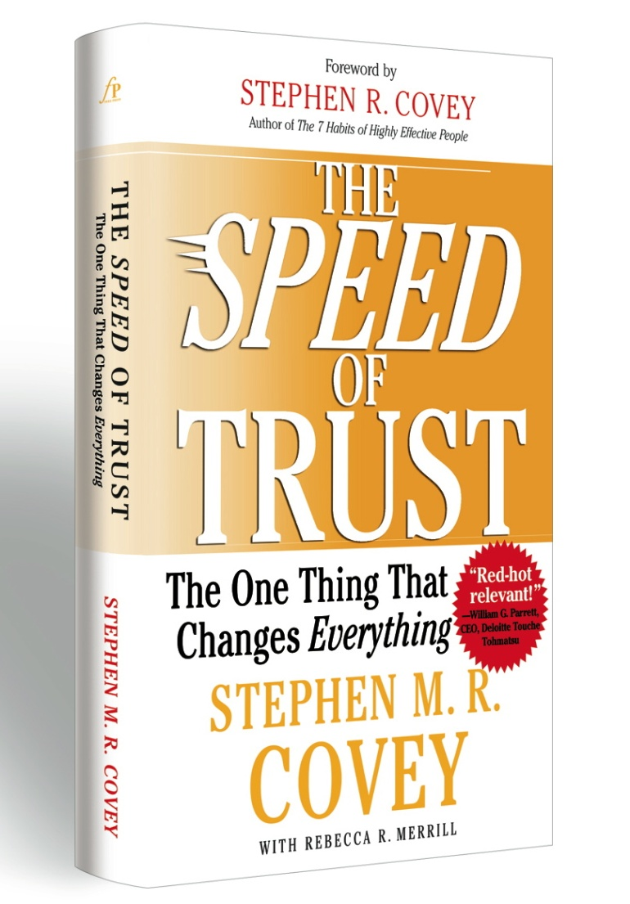
The Speed of Trust Stephen Covey

Slide 180
Trust Affects Speed and Costs

Slide 181
The Speed of Trust
Trust = Speed Costs
Trust = Speed Costs
Distrust is very Expensive

Slide 182
Trust Affects Speed and Costs
Warren Buffett

Slide 183
Warren Buffett | Wal-Mart We did no ‘due diligence.’ We knew everything would be exactly as Wal-Mart said it would be – and it was.
Trust = Speed Costs

Slide 184
High Trust is a Performance Multiplier It Creates Trust Dividends

Slide 185
High Trust Materially Improves Communication, Collaboration, Execution, Innovation, Strategy, Engagement, Partnering and Relationships.

Slide 186
Mistrust
Increases the cost of doing business Trust Tax

Slide 187
Trust Is the Hidden Variable

Slide 188
Traditional Formula for Organizational Success S x E = R . Strategy x Execution = Results 10 x 10 = 100

Slide 189
New Formula for Organizational Success . (S x E) x T = R (Strategy x Execution) Trust = Results

Slide 190
(S x E) x T = R Strategy x Execute = Result x Trust = Net
Trust Tax
10 x 10 = 100 less 40% = 60

Slide 191
(S x E) x T = R Strategy x Execute = Result x Trust = Net
Trust Tax
10 x 10 = 100 less 40% = 60
Trust Dividend
10 x 10 = 100 plus 20% = 120

Slide 192
High Trust won’t necessarily rescue poor Strategy.
Low Trust will almost always derail a good Strategy.

Slide 193
The ability to Establish, Grow Extend, & Restore Trust with all stakeholders – is the key leadership competency of the new global economy. Stephen Covey

Slide 194
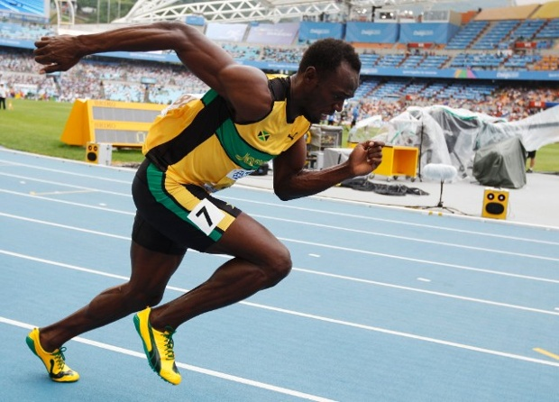
Nothing is as Fast as the Speed of Trust

Slide 195
Who do I Trust?

Slide 196
Who Trusts me?

Slide 197
Myth Trust is a function of Character

Slide 198
Trust is a function of
Competence
And
Character

Slide 199
Competence
Your Capabilities
Your Skills
Your Results
Your track record

Slide 200
Your Integrity
Your Motive
Your Intent
Character

Slide 201
Competence
Is Situational
Based on what the circumstances require.
Character
Is a Constant
Necessary for Trust in all situations.

Slide 202
Trust is a function of
Competence
And
Character

Slide 203
What is the Criteria? for Partnerships, Team Core Relationships

Slide 204
Criteria for Partnerships
3Cs

Slide 205
Criteria for Partnerships
3Cs
Context
Competence
Character

Slide 206
Choose your Partners Well!
3Cs

Slide 207
Awakening Excellence
Systems, Strategies and Concepts for Awakening Excellence

Slide 208
Trust

Slide 209
Relational
Trust
Requires Consistent
Trust Building
Behaviors

Slide 210
Relational
Trust
13 Behaviors
There are 13 Behaviors common to
high-trust leaders throughout the world.
These Behaviors will significantly enhance your ability to establish and if necessary
re-establish trust in all relationships -
both professional and personal.

Slide 211
You can’t talk yourself out
of a problem you’ve
behaved yourself into.
But you can behave
yourself out of a problem
you behaved yourself into!
Stephen M.R. Covey

Slide 212
The best time
to plant a tree
is 20 years ago.
The second best time
is now.
Chinese Proverb

Slide 213
13 Behaviors
1. Talk Straight
2. Demonstrate Respect
3. Create Transparency
4. Right Wrongs
5. Show Loyalty
6. Deliver Results
7. Get Better
8. Confront Reality
9. Clarify Expectations
10. Practice Accountability
11. Listen First
12. Keep Commitments
13. Extend Trust

Slide 214
Breathing

Slide 215
Awakening Excellence
Systems, Strategies and Concepts for Awakening Excellence

Slide 216
Relational
Trust
13 Behaviors Exercise
Write down
A Challenging Relationship.

Slide 217
Them
Behavior | Current Performance | Conflicting Counterfeit
Talk Straight |  | Lie, spin, tell half truths, double talk, flatter.
Demonstrate Respect |  | Don’t care or don’t show you care; show disrespect or show respect only to those who can something for you.
Create Transparence |  | Withhold information; keep secrets; create illusions; pretend.
Right Wrongs |  | Don’t admit or repair mistakes; cover up mistakes.

Slide 218
Them
Behavior | Current Performance | Conflicting Counterfeit
Talk Straight |  | Lie, spin, tell half truths, double talk, flatter.
Demonstrate Respect |  | Don’t care or don’t show you care; show disrespect or show respect only to those who can something for you.
Create Transparence |  | Withhold information; keep secrets; create illusions; pretend.
Right Wrongs |  | Don’t admit or repair mistakes; cover up mistakes.

Slide 219
*
You
Behavior | Current Performance | Conflicting Counterfeit
Talk Straight |  | Lie, spin, tell half truths, double talk, flatter.
Demonstrate Respect |  | Don’t care or don’t show you care; show disrespect or show respect only to those who can something for you.
Create Transparence |  | Withhold information; keep secrets; create illusions; pretend.
Right Wrongs |  | Don’t admit or repair mistakes; cover up mistakes.
*
*
*
You
Them
*
*

Slide 220
*
You
Behavior | Current Performance | Conflicting Counterfeit
Talk Straight |  | Lie, spin, tell half truths, double talk, flatter.
Demonstrate Respect |  | Don’t care or don’t show you care; show disrespect or show respect only to those who can something for you.
Create Transparence |  | Withhold information; keep secrets; create illusions; pretend.
Right Wrongs |  | Don’t admit or repair mistakes; cover up mistakes.
*
*
*
You
Them
*
*

Slide 221
You can’t talk yourself out
of a problem you’ve
behaved yourself into.
But you can behave
yourself out of a problem
you behaved yourself into!
Stephen M.R. Covey

Slide 222
Breathing

Slide 223
Awakening Excellence
Systems, Strategies and Concepts for Awakening Excellence

Slide 224
Systems, Strategies and Concepts.1

Slide 225
Energy Management

Slide 226
It’s not Time Management . Energy and Time Management

Slide 227
What If ?
The Answer is Always the Same!
Breathe, Feel, Vibrate and Be Present
Enter into Love and Sobriety,
Act Impeccably
Enter into Love and Sobriety
and Act Impeccably

Slide 228
Communicate Communicate Communicate Then Communicate more.

Slide 229
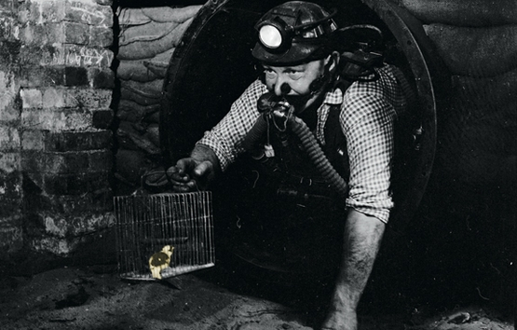
Your experience is valid. Your input is needed.

Slide 230
All Action: “By Agreement”

Slide 231
“By Agreement”
Empowered Requests
Empowered Listening
Empowered Promise
No Assumptions

Slide 232
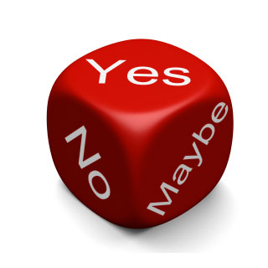
Decision Making
By Agreement,
Decide How we
are going to Decide.
(Ahead of time! | 1st 15%)

Slide 233
Decision Making By Agreement
Unilateral / Command
Consult / Command
Vote: Majority, 80/20
Consensus
Compromise

Slide 234
Consensus
vs
Buy In

Slide 235
What is
Buy In
1-10
7? 9? 10?

Slide 236
10
Buy In is
I am Willing
I am Committed

Slide 237
Consensus
“A position reached where everyone agrees.”
Buy In
“100% Commitment
to support a decision.”

Slide 238
Buy In
“I’ve been heard, I have some differences, and I back this.”

Slide 239
Decision Making By Agreement
Unilateral / Command
Consult / Command
Vote: Majority, 80/20
Consensus
Compromise

Slide 240
Options Discussion
“Conversation for possibilities…”
vs
Making a Decision
“Conversation for action…”
Acknowledge which you are doing.

Slide 241
Options Discussion
We are now looking at Options and will
announce when we are making a Decision.
And
We have pre-Agreed how we are going to Decide
Making a Decision
By clear Agreement:
I/We are now making a Decision.

Slide 242
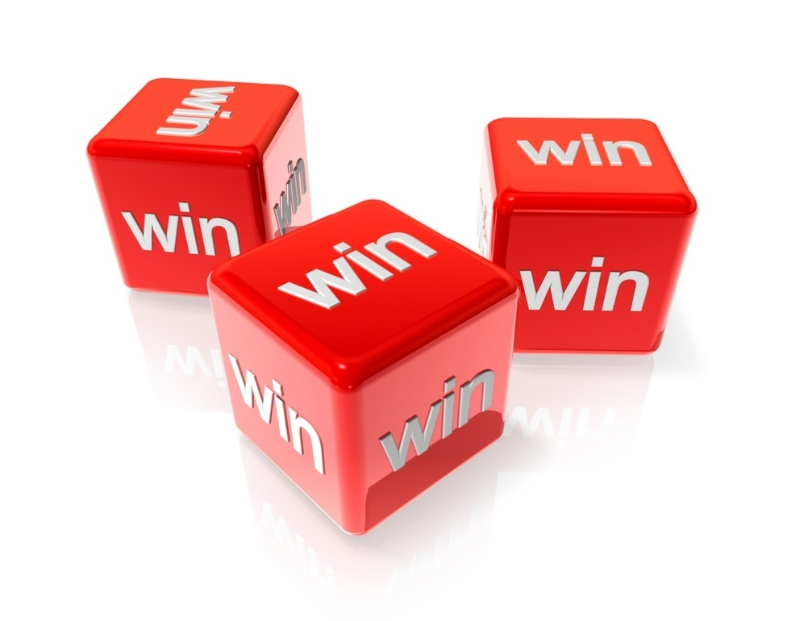
Win, Win, Win

Slide 243
Commit to the Truth.
“What’s True?”
Be open to a new possibility.

Slide 244
The Truth is always Beautiful.
No matter what process
it may trigger.
Sanity | Liberation | Simplicity

Slide 245
Authentically Reveal rather than Conceal. Revealing Creates Safety

Slide 246
Authentically Reveal. Make it…
Appropriate
Pertinent
Functional
Receivable

Slide 247
Speak from
I instead of You.
Speak
“Body Centered Truth”
Is inarguable

Slide 248
Release
“No Disturbance Decision”
Some disturbance is ok.
Be responsible.
Don’t direct your energy.
Expect and co-create Resolution.

Slide 249
Change Model
“Change can be easy”
Crisis
Pain
Discomfort
Point Easy

Slide 250
Awakening Excellence
Systems, Strategies and Concepts for Awakening Excellence

Slide 251
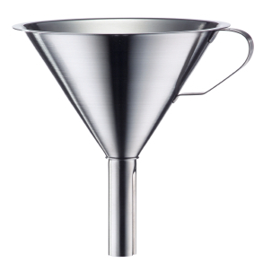
Funneling Funnel your declaration. Speak impeccably.

Slide 252
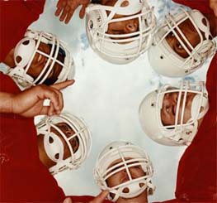
Huddle

Slide 253
Huddle
Max 4 Minute
Standing Up
Time Keeper
Move on

Slide 254
Customer Complaint
Is a Request to be Loyal.
(Internal and External)

Slide 255
What is the most powerful WORD in the English language?

Slide 256
AND And, And, And…
Speak the Whole picture.

Slide 257
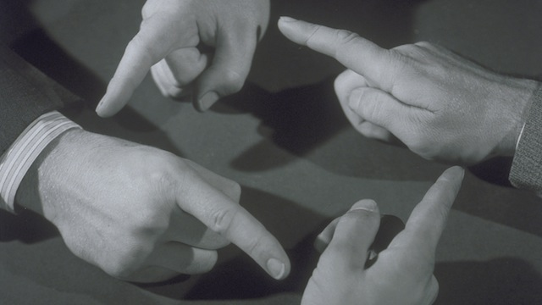
Release Blame and “Who’s Fault is it?”

Slide 258
Let Go Of Blame. Everyone is Responsible. Everyone is accountable. And no one is to Blame.

Slide 259
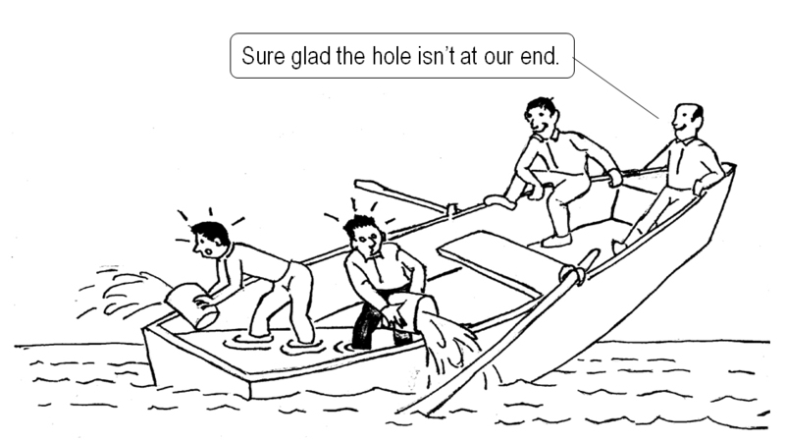

Slide 260
No One is to Blame. Commit to: Co-Creation Co-Resolution 100% Responsible

Slide 261
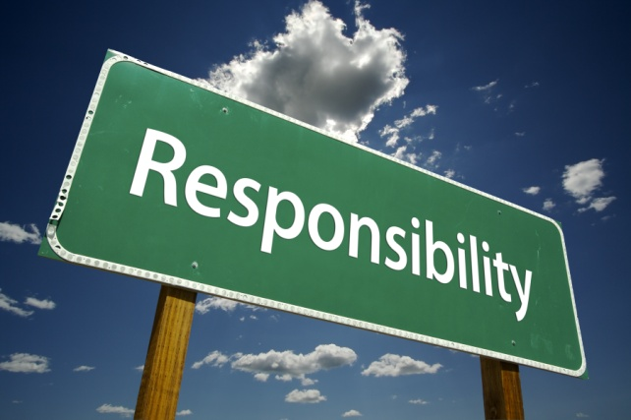
100% Responsible. Accept It Change It Or Leave it

Slide 262
Breathing

Slide 263
Awakening Excellence
Systems, Strategies and Concepts for Awakening Excellence

Slide 264
Systems,
Strategies
and Concepts.2

Slide 265
Acknowledgement
Appreciation
Gratitude

Slide 266
Two Acknowledgments and a Request

Slide 267
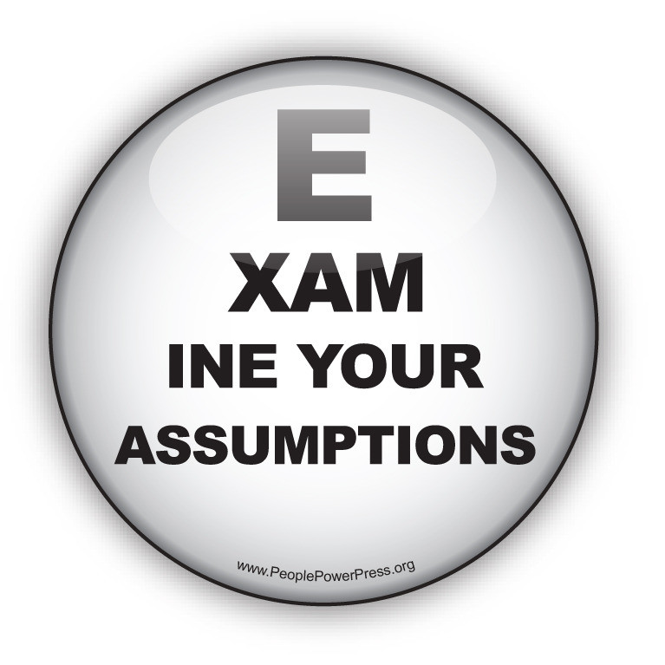
95% of all Drama
is based on Assumptions.
“I saw, I heard, I assumed!”

Slide 268
Your Path
See
Hear
Sense
-Story
Is that True?
Assumptions?

Slide 269
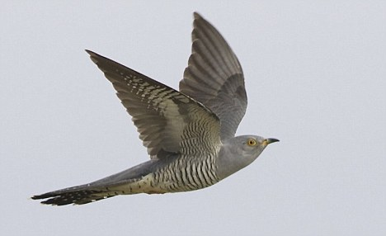
Learning
Curve

Slide 270
Learning
Curve

Slide 271
Learning
Curve

Slide 272
Whole Process
Integral

Slide 273
Domain, Context, Paradigm
Integral
Denial
Addiction
Survival
It's Your Choice.

Slide 274
Whole Process
Breathe, Be Present
Embrace and Vibrate Emotions
Release Limiting Beliefs
Declare New Intention
Empowered Action

Slide 275
Mar 22-26

Slide 276
Diminishing Returns
Diminishing Returns
Return
Effort

Slide 277
Diversity
Appreciate and Embrace
Differences

Slide 278
Incompletions
and the
Willingness
to
Heal and Resolve

Slide 279
Embrace rather than Deny
Leads to Resolution

Slide 280
Breakdown
Breakthrough

Slide 281
Breakthrough
Breakthrough

Slide 282
I Commit to Love Myself
No Matter What the Evidence
And
Feel the Healthy Shame
Learn, gain Wisdom
Change Behavior and Choices
Do Empowered Action

Slide 283
Spiral
What do YOU do to start
a Downward Spiral?
You don’t have to go all the
way down to the bottom.
Catch yourself early
and spiral upward.

Slide 284
How do you
Increase Profits?

Slide 285
1.1% decrease in Waste
is the same as
10% increase in Sales
To Increase Net Profit by 10%
For company with 10% Net Profit

Slide 286
Systems

Slide 287
Systems
94% of all Failures
are Systems Failures

Slide 288
Business Excellence
Products, Services
People, Relationships, Teams
Systems

Slide 289
Breathing

Slide 290
Awakening Excellence
Systems, Strategies and Concepts for Awakening Excellence

Slide 291
Whole Process
Integral

Slide 292
Domain, Context, Paradigm
Integral
Denial
Addiction
Survival
It's Your Choice.

Slide 293
Whole Process
Breathe, Be Present
Embrace and Vibrate Emotions
Release Limiting Beliefs
Declare New Intention
Empowered Action

Slide 294
Mar 22-26

Slide 295
Awakening Excellence

Slide 296
Team Agreements
Team-Partnership

Slide 297
Team
Agreements

Slide 298
Breathing

Slide 299
Awakening Excellence
Systems, Strategies and Concepts for Awakening Excellence

Slide 300
90 Sec Burst
Metabolic Activation

Slide 301
90 Sec Burst
Benefits of Bursting
Fast weight loss
Minimum risk to your joints
Incredible gains in strength
Simplicity
Extremely varied
Improves Mental Health
Improves State of Mind

Slide 302
90 Sec Burst
Recent psychology studies performed & published worldwide say that…..
Practicing sports or basic exercises:
- relieves stress,
- keeps an individual in a right state of mind
- most of all helps build confidence
- & individual appreciation of oneself
due to its amazing results.

Slide 303
90 Sec Burst
Oxygenates the Brain
High-intensity interval training
in particular dilates blood vessels, lowers inflammation, and improves blood flow to the brain. This involves reaching your maximum heart rate with just a short but vigorous burst of exercise, resting, and repeating.

Slide 304
90 Sec Burst
RULE 1
Focus on how you Feel.
Not on Losing Weight.

Slide 305
90 Sec Burst
RULE 2
You’re not exercising. Exercise is long and hard.
You’re Bursting for 90 seconds!

Slide 306
90 Sec Burst
RULE 3
No finish line.
No target dates.
This is life style that will lead to Weight Health.

Slide 307
90 Sec Burst
RULE 4
No Perfectionism.
Do it once a day and you’ll feel
great And then naturally you’ll
WANT to do it before and after
meals automatically.

Slide 308
90 Sec Burst
RULE 5
Go for Consistency.
If you remember in the middle of a
meal, standup do a 90 Sec Burst,
or do it after the meal.

Slide 309
Awakening Excellence
Systems, Strategies and Concepts for Awakening Excellence

Slide 310
Mission Statement
WorldVentures is creating
more fun, freedom and fulfillment
in people's lives through the merging of
great life experiences, financial opportunity,
learning and contribution.

Slide 311
We are a
Values and
Commitment
Based Culture

Slide 312
Awakening Excellence
Core Values

Slide 313
1
Live
Fun, Freedom
and Fulfillment

Slide 314
Mission Statement
WorldVentures is creating
more fun, freedom and fulfillment
in people's lives through the merging of
great life experiences, financial opportunity,
learning and contribution.

Slide 315
2
We are
One
Big Team

Slide 316
3
Honor,
Embody
And Expand
Trust

Slide 317
4
Deliver and Promote
Excellence

Slide 318
5
Commit to
Resolution

Slide 319
6
Care
and
Contribute

Slide 320
7
Champion
Full Potential

Slide 321
8
Embrace
Creativity
and
Innovation

Slide 322
9
Foster
Safe and Open
Communication

Slide 323
10
Ensure
Sustainability
In
Everything we Do

Slide 324
We are a
Values and
Commitment
Based Culture

Slide 325
Breathing

Slide 326
Whole Process
Integral

Slide 327
Domain, Context, Paradigm
Integral
Denial
Addiction
Survival
It's Your Choice.

Slide 328
Whole Process
Breathe, Be Present
Embrace and Vibrate Emotions
Release Limiting Beliefs
Declare New Intention
Empowered Action

Slide 330
Team-Partnership

