Slide 1
Awakening Excellence.2

Slide 2
Breathing

Slide 3
Five Islands

Slide 4
Relationships
Which has the best Economic Potential?

Slide 5
Relationships
Are the Foundation of All Economics
Higher Connectivity & Functionality =
Higher Economic Potential

Slide 6
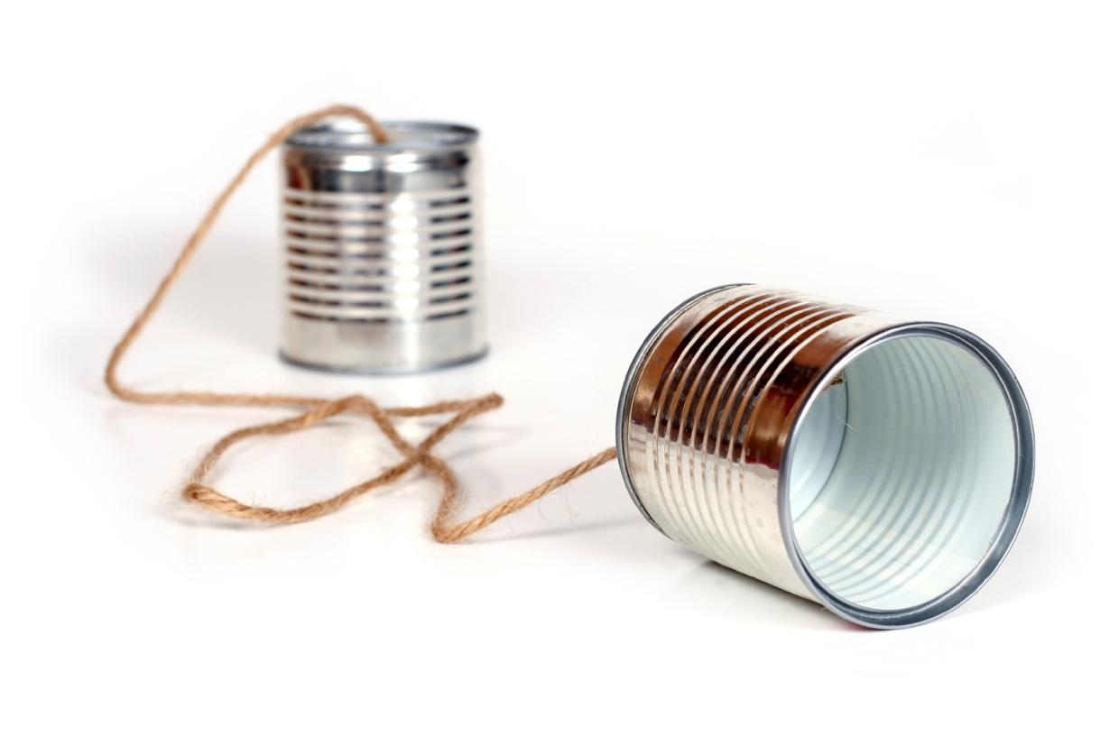
Empowered
Communication.1

Slide 7
Empowered Communication
Creates Results

Slide 8
Empowered Communication
Requires
Active Listening
Empowered Requests
Empowered Promises

Slide 9
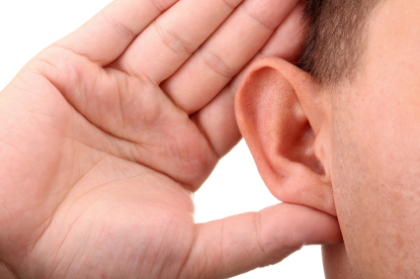
Empowered Communication
Active Listening
"Clarity Brings
Power."

Slide 10
Empowered Communication
Actively Listen
to
What is Said
(Hear, See, Feel and Sense)
For clarity
Repeat what was Said.
"Is what I have repeated correct?”

Slide 11
Empowered Communication
Actively Listen
to
What is Heard
(Hear, See, Feel and Sense)
For clarity
Ask listener to repeat.
“For clarity could you repeat what I said?”

Slide 12
Empowered
Requests
Creates Results

Slide 13
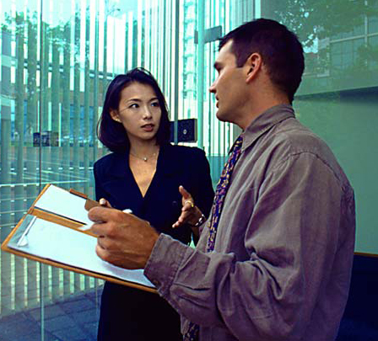
Empowered Requests
“I have a Request.”

Slide 14
Empowered Requests
“I have a Request.”
Why
Qualifications for Satisfaction
Time Line
Considerations
Listen the Promise
Consequences

Slide 15
Empowered
Communication
Write Down an Empowered Request

Slide 16
Empowered Communication
Empowered
Promises
Create Results

Slide 17
Empowered Communication
Empowered Promise
“I Promise.”

Slide 18
Empowered Promise
Understand the Why
“I Promise.”
To Satisfy the Qualifications
Time Line
Considerations
Listen my Promise
Consequences

Slide 19
Empowered Promise
Agreements
I will keep my
Promises and Commitments
Promises and Commitments
Can only be changed by agreement.

Slide 20
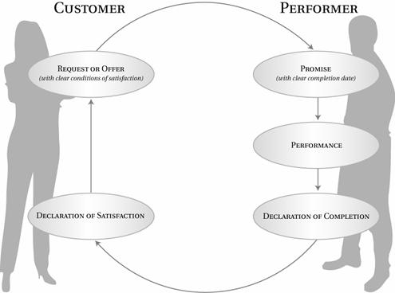
Conversation for Action Cycle
Requester
Performer
Conversation
For Action
Empowered Request
Empowered Promise
Authentic Revealing
Considerations
Suggestions
Performance
Declaration
Of Satisfaction
Declaration
of Completion
Resourced from Fernando Flores

Slide 21
Empowered
Communication.2

Slide 22
Challenging Conversations

Slide 23
Challenging
Conversations
Are conversations that take place when
the stakes are high, opinions differ,
and emotions run strong.
How you handle challenging conversations
can determine your success in your most important relationships, whether at home,
at work, or in a social organization.

Slide 24
The Signs of
Challenging Conversations
When you feel
Stuck, Stressed, Emotions,
Body Symptoms
Behaviors, Acting Out, Raising Voice, Withdrawing or Withholding.
There is a
Challenging Conversation
You need to Have.

Slide 25
Change Model
Crisis
Pain
Energy and $
Discomfort
Point Easy
Time
“Change Can Be Easy”

Slide 26
Are there Challenging Conversations You need to have?
Identify challenging conversations
that you’re not holding or not holding well.
Write the title of these on a sheet of paper.

Slide 27
Communication for Resolution
Model
Dialogue
For Resolution
Pool of Shared Meaning
“The pool of shared meaning is the birthplace of Synergy.”

Slide 28
Communication for Resolution
Silence
Withdrawing, Avoiding, Masking
Safety
Dialogue
For Resolution
Pool of Shared Meaning
Safety
Controlling, Labeling, Attacking
Violence

Slide 29
Dialogue Goals
Denial Context Unhealthy Goals
Be Right
Look Good Save Face
Keep the Peace
Avoid Conflict
Win - Lose
Punish, Blame
Separate and Isolate
Integral Context
Healthy Goals
Find the Truth
Admit. Learn. re-Commit.
Acknowledge Challenge
Commit to Resolution
Win - Win. Produce Results
Request and Resolve
Inclusion, Synergy, Partnership

Slide 30
Start and Stay with Heart
Work on me First.
What do I really want?
What do I really want for myself?
What do I really want for others?
How would I behave
if this is what I really wanted?

Slide 31
Refuse Either Or Thinking
Search for an
And
Clarify what you don’t want
Ask brain to search for healthy options
There is a Resolution What is it?

Slide 32
Learn to Look
Look at Content and Conditions
Watch for Safety problems
Look for people moving towards
Silence and Violence
Look for your Style Under Stress

Slide 33
When you or others are moving toward
Silence or Violence
Make it Safe
Step out of Content
Out of Conversation
And Make it Safe

Slide 34
Make it Safe
Which Condition of Safety is at Risk?
Mutual Purpose
Do others believe you care about their goals?
Mutual Respect
Do others believe you respect them?

Slide 35
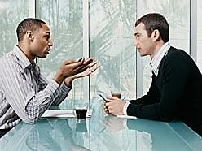
Make it Safe
When there is Misunderstanding
Use
Contrasting
Start with what you don’t intend and mean.
Explain what you do intend and mean.

Slide 36
Tough Message to Share
State Your Path

Slide 37
Your Path
See
Hear
Sense
-Story
Is that True?

Slide 38
Your Path
See
Hear
Sense
- Story
- Feel
-Act

Slide 39
Communication for Resolution
Silence
Withdrawing, Avoiding, Masking
Safety
Dialogue
For Resolution
Pool of Shared Meaning
Others
See
Hear
Sense
Me
See
Hear
Sense
-Story
-Story
-Act
Act
-Feel
-Feel
Safety
Controlling, Labeling, Attacking
Violence

Slide 40
Tough Message to Share
State Your Path
Share your Facts
Start with least Controversial
Tell your Story
The meanings you are giving to the facts.
Ask Others for their facts and Stories
Dialogue for Resolution

Slide 41
Dialogue for Resolution
Agree
When you do.
Apologize
Quickly when appropriate.
Build
If others leave things out
Agree where you do then Build…. (AND)
Compare
When you differ significantly
Don’t suggest they are wrong. Compare the two Views.

Slide 42
Dialogue for Resolution
Mutual Purpose
Pool of Shared Meaning
What do I Really Want
Move Energy
Search for And
Watch for Safety
Active Listening
Contrasting
Share Your Path
Resolution

Slide 43
Communication for Resolution
Silence
Withdrawing, Avoiding, Masking
Safety
Dialogue
For Resolution
Pool of Shared Meaning
Others
See
Hear
Sense
Me
See
Hear
Sense
-Story
-Story
-Act
Act
-Feel
-Feel
Safety
Controlling, Labeling, Attacking
Violence

